Slide 1
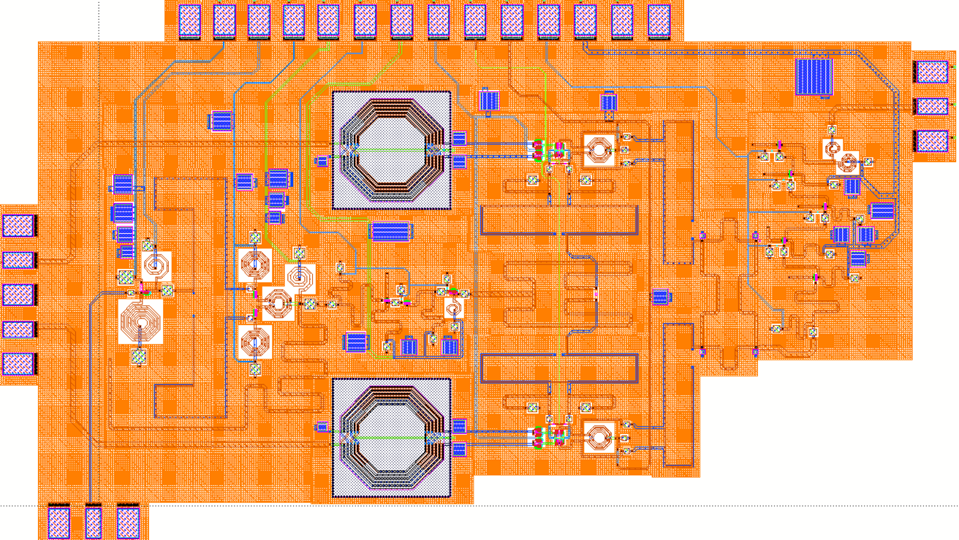
Design of Q-band Transmitter using 65nm CMOS Technology
Hyunkyu Lee, Seungwon Park and Sanggeun Jeon
School of Electrical Engineering, Korea University, Seoul 136-713, Korea
Introduction
Q-band transmitter MMIC
Q-band transmitter is fabricated using a 65-nm CMOS process.
This system consists of a 40-GHz frequency quadrupler, up-conversion mixer, two drive amplifier and additional passive components.
Simulated results show that the maximum conversion gain is 11-dB and 3-dB bandwidth is 5.3-GHz.
Mm-wave CMOS transmitter block diagram & layout
Q-band transmitter unit circuits
40-GHz frequency quadrupler
IF
Balun
Up-mixer
RF
Balun
RF
Drive
Amplifier
RF
Output
Frequency
Quadrupler
LO Balun
RF
Hybrid
IF
Hybrid
Input
Drive
Amp
Wilkinson
Divider
  40-GHz quadrupler using cascaded two doubler
  Class-B biasing for 2nd harmonic enhancement
  1st doubler : Single-to-single topology for size reduction
  2nd doubler : Differential-to-single topology for fundamental suppression
LO Balun
RF
Balun
IF
Balun
Up-mixer
Synthesizer
Input
Up conversion mixer
  Q-band transmitter is fabricated using a 65-nm CMOS process
  Size : 1650ⅹ2780 um²
Simulation results
[Pin vs Pout, CG @ 3GHz IF input]
[Output freq vs CG @ -20dBm input]
  Q-band gilbert-cell up-conversion mixer
  Inverting amplifier is inserted for improving conversion gain and bandwidth performance
Drive amplifier
[Input freq vs IMRR @ -20dBm input]
[Output freq vs Psat]
  1.2-dBm OP1dB with 3-GHz -9dBm input
  Conversion gain : 11-dB (max)
  Bandwidth (3dB) : 5.3-GHz (Freq_{RF} : 41.8 – 46.1 GHz)
  IMRR : 47-dB (max), > 32-dB (CG 3-dB)
  5-stage single-ended CS topology
  Improve stability using source-degeneration
  Providing sufficient output power to drive up-conversion mixer
The Authors thank IDEC for MPW and CAD tool support

